Slide 1
P. KIRUTHIKA
112721214009
3/21/2024 Annual Review

Slide 2
PROJECT TITLE Credit card default prediction
3/21/2024 Annual Review

Slide 3


AGENDA Introduction Problem statement project overview solution modelling results
3/21/2024 Annual Review

Slide 4

PROBLEM STATEMENT
This project is aimed at predicting the case of customers' default payments in Taiwan. From the perspective of risk management, the result of predictive accuracy of the estimated probability of default will be more valuable than the binary result of classification - credible or not credible clients. We can use the K-S chart to evaluate which customers will default on their credit card payments.
3/21/2024 Annual Review

Slide 5

PROJECT OVERVIEW Credit card default prediction is a critical task for banks and financial institutions to assess the creditworthiness of individuals applying for credit cards. It involves using historical data on customer behavior and payment patterns to predict the likelihood of a customer defaulting on their credit card payments in the future. The process typically involves collecting and preprocessing data, selecting relevant features, and building a predictive model using techniques such as logistic regression, decision trees, or machine learning algorithms like random forests or gradient boosting. The model is then evaluated using metrics like accuracy, precision, recall, and ROC-AUC to assess its performance. By accurately predicting credit card defaults, banks can better manage risk, optimize credit card approval processes, and tailor credit limits and interest rates to individual customers.
3/21/2024 Annual Review

Slide 6

WHO ARE THE END USERS? End users of credit cards are individuals who use credit cards for making purchases or transactions. They are the consumers who hold the credit cards issued by banks or financial institutions. End users of credit cards can include individuals from various demographics and financial backgrounds who use credit cards for convenience, rewards, or other benefits offered by the card issuer.
3/21/2024 Annual Review

Slide 7

YOUR SOLUTION AND ITS VALUE PROPOSITION The solution and value proposition of credit card default prediction lie in its ability to help banks and financial institutions mitigate risks associated with lending and manage their portfolios more effectively. Here's how: Risk management Cost reduction Improved decision making Customer retention Regulatory compliance
3/21/2024 Annual Review

Slide 8

THE WOW IN YOUR SOLUTION In the context of credit card default prediction, the "wow" factor in the solutions could come from several aspects, including: Precision and Accuracy: A predictive model that can accurately identify potential defaulters with a high degree of precision, minimizing false positives and maximizing the efficiency of risk management strategies. Real-time Monitoring: The ability to continuously monitor customer behavior and payment patterns in real-time, allowing for timely interventions and proactive measures to prevent defaults.
3/21/2024 Annual Review

Slide 9
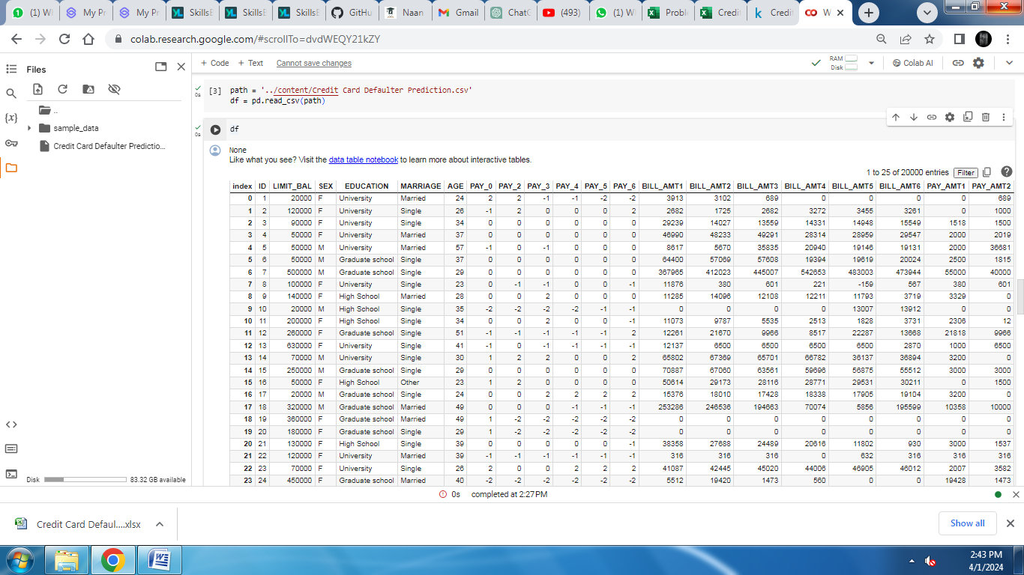
RESULTS
Demo Link
3/21/2024 Annual Review

